Slide 1


Light communication for sensors

Slide 2
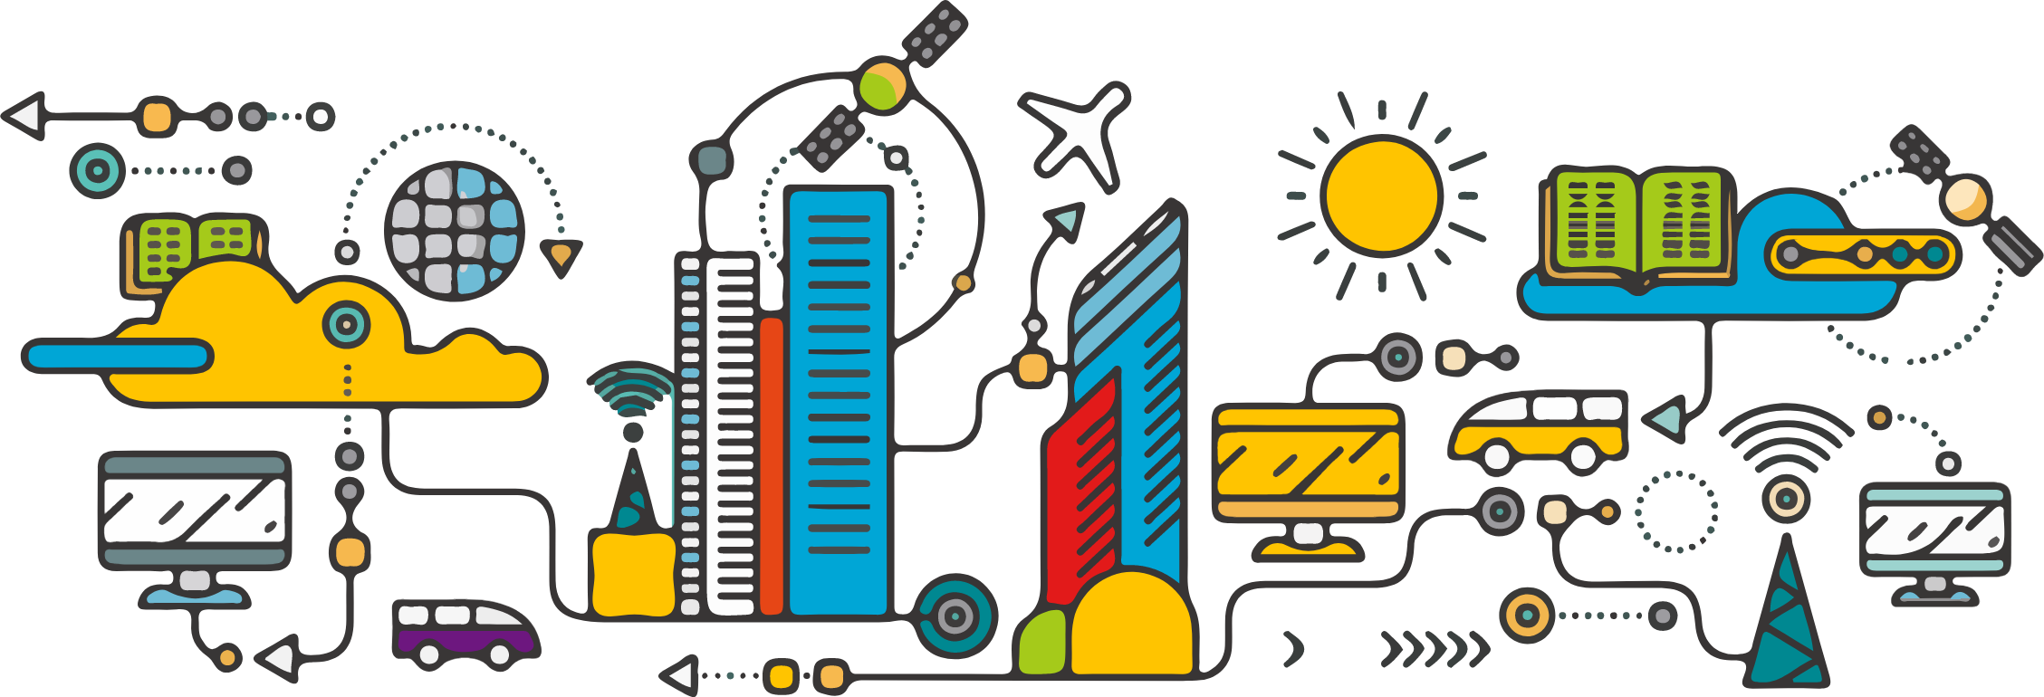
The future: smart cities
Sensors everywhere
Notes:
Let’s take a look into the future: We see smart cities in which connectivity of devices grows.
There are sensors everywhere and that is a good thing. Sensors can help monitoring the quality of life within the city. You can think of sensors to measure air pollution, traffic flows and temperature changes.

Slide 3
The future: smart cities
Challenge: communication
Notes:
Challenge: communication
Communication is expensive: In 2013 we were already using more energy to move bits and bytes on the Internet, than by flying airplanes over the whole world. Wireless communication like 4G, Bluetooth or WiFi always consumes a lot of energy. Adding more of those signals is a waste of energy, and present signals can degrade the communication quality and speed.

Slide 4

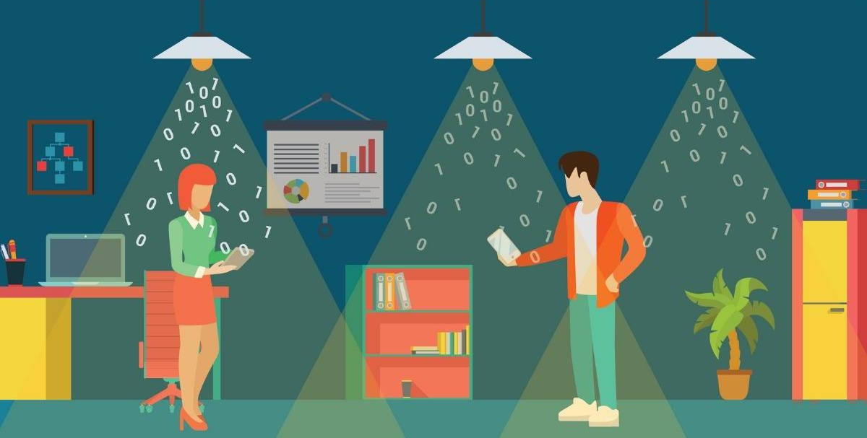
The future: smart cities
LiFi: use the lights
Notes:
One solution (if the challenge is a problem), would be LiFi.
I don’t think we always want to turn on lights at daytime to enable WiFi. That would be a larger waste of energy than using WiFi.

Slide 5
The future: smart cities
LuxSenz focuses on sunlight
Notes:
In this city, we focus on sunlight.
The sun is an abundant resources that provides energy.
We use the energy of the sun for communication.
Natural soure of energy
We do not only use solar panels, but make light the motor/carrier of the wireless communication.
We do not need radio waves

Slide 6

The future: smart cities
Reflecting the light = data
Notes:
How does it work?
Every object reflects light. If I would were a blue or a white shirt, that already makes a difference.
By controlling reflections digitally, we can transmit sensor data directly.
Data from sensors on different buildings can be collected with minimal energy: only the collection point then needs internet.

Slide 7
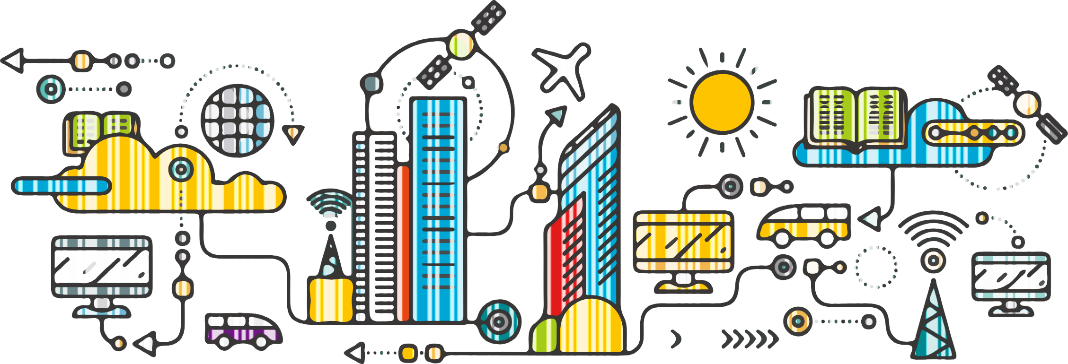
Demo time!
Notes:
A vision could be to have everything in a city communication through visible light reflections.
The idea to use LuxSenz is hard to sell, but the technology works.

Slide 8
The present: connecting cities
Automation is going on
Notes:
Let’s go back to the city as it is now. More and more processes are automated by installing sensors and that is definitely an improvement.
We should look for urban challenges that need a bit of innovation to be solved: as a university we can offer innovative projects.

Slide 9
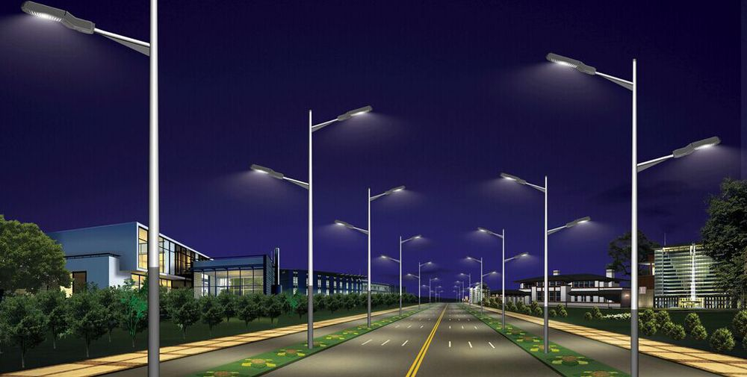
The present: defect street lights
Usually everything works fine…
Notes:
Let’s go back to the city as it is now

Slide 10

The present: defect street lights
How would you detect a defect light?
Notes:
Let’s go back to the city as it is now

